Slide 1
GAMS code, modules & realizations
How do the magpie folder and code look like?
Presenter: Edna J. Molina Bacca
mbacca@pik-potsdam.de
April 10th, 2024

Slide 2
Outline
What is GAMS?
General structure of the MAgPIE Model
The magpie folder: Components of MAgPIE, the structure of modules and realizations, and the full.gms file
Coding etiquette: Variable and parameter naming
Brief exercise

Slide 3
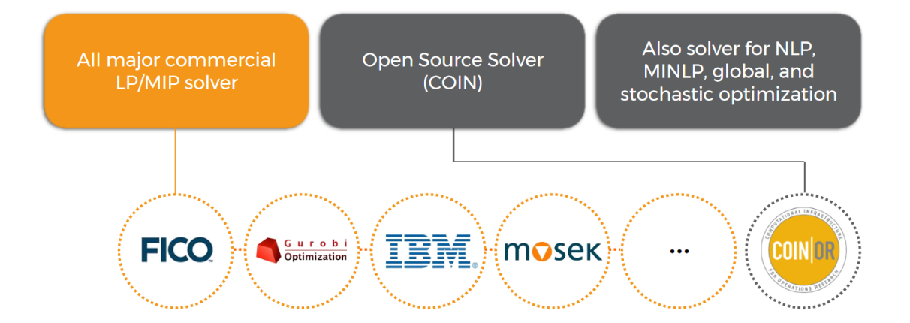
What is GAMS?
MAgPIE is written in the General Algebraic Modeling System (GAMS) language
“GAMS is a high level modeling system for mathematical programming and optimization. It consists of a language compiler and a range of associated solvers.”
Useful links:
GAMS at a glance: https://www.gams.com/products/gams/gams-language/
GAMS documentation: https://www.gams.com/latest/docs/

Slide 4
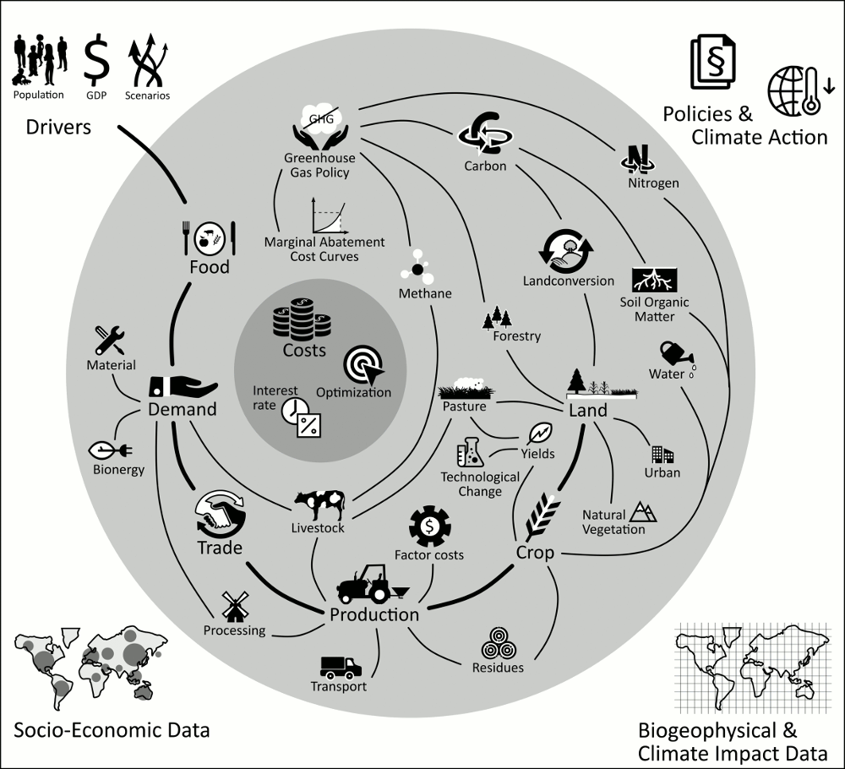
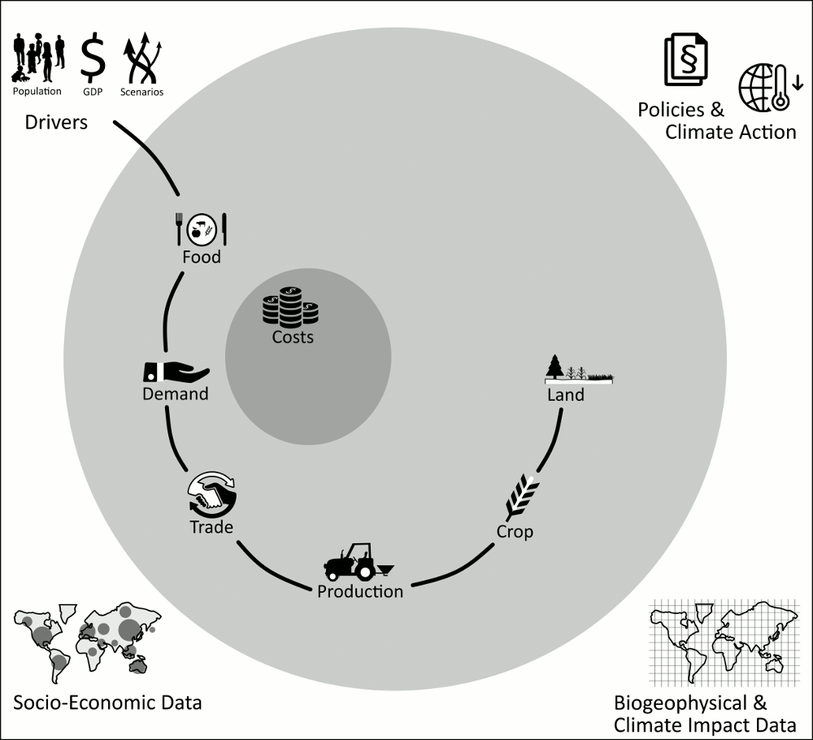
General structure of the MAgPIE Model
Future population and GDP are the main drivers (different scenarios).
Food consumption patterns lead to certain demand
Trade patterns leads to regional production
Production and biophysical yield and water availability data translate into cropping patterns.
Cropping patterns drive land use decisions
These interactions and calculations are described in MAgPIE‘s modules
More info at: https://rse.pik-potsdam.de/doc/magpie/4.7.2/

Slide 5
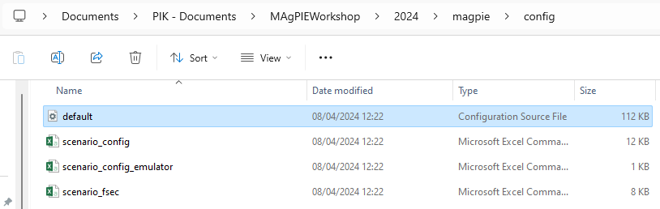
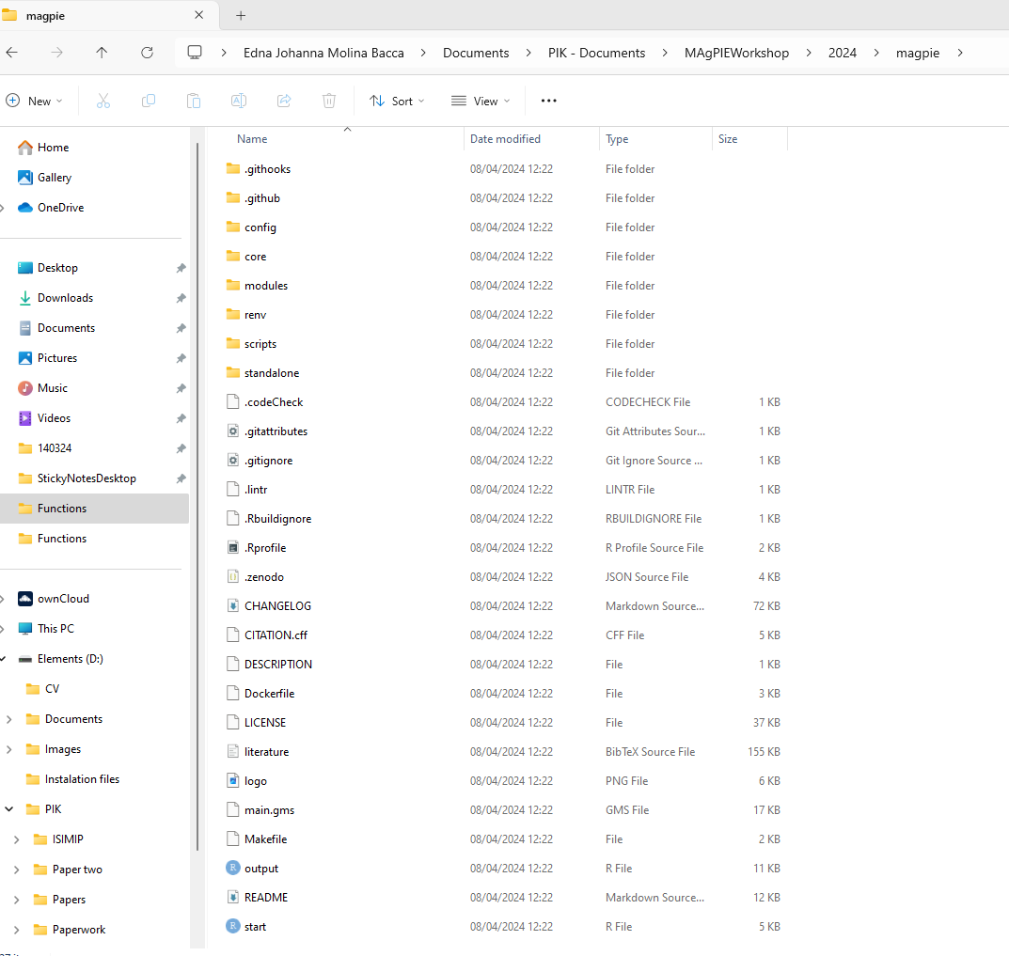
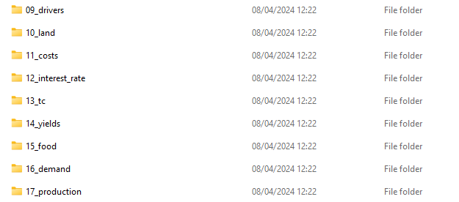


The magpie folder: Components of MAgPIE
After you have cloned the magpie folder (git clone https://github.com/magpiemodel/magpie.git) from the repository you will find :
The configuration settings are set in the default.cfg file (or in the stat scripts)
*
*
*
45 modules and the include.gms file
Each folder within the modules folder represent a component of the model and contains different realizations (approaches to that component)

Slide 6
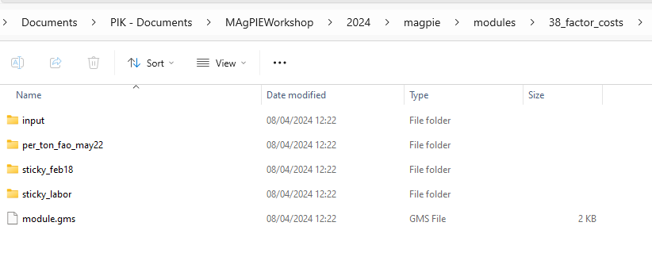
Structure of the modules
Each module (within the modules folder) has a similar structure:
Input folder with input files for all realizations
}
Realization folders containing the source code of each realization
The modules.gms file with the module description and listing of all realizations
New realizations can be added by keeping the same structure. In that sense, MAgPIE is easily extendable.

Slide 7
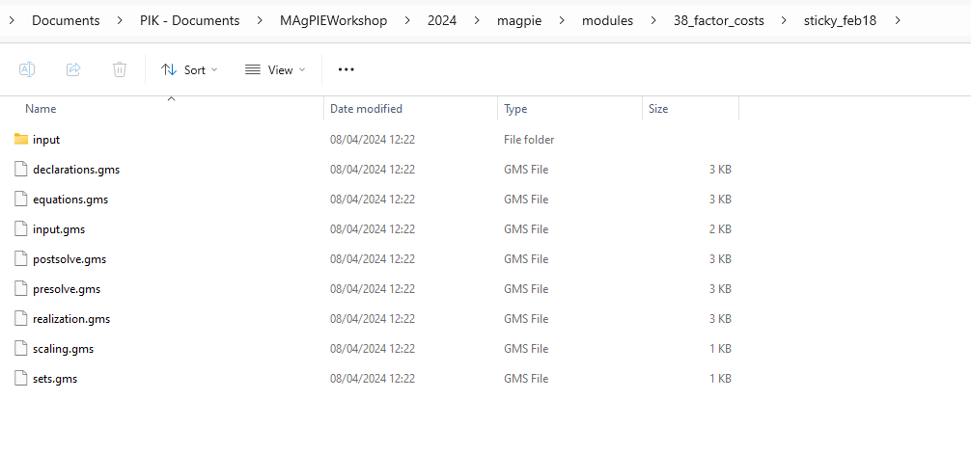
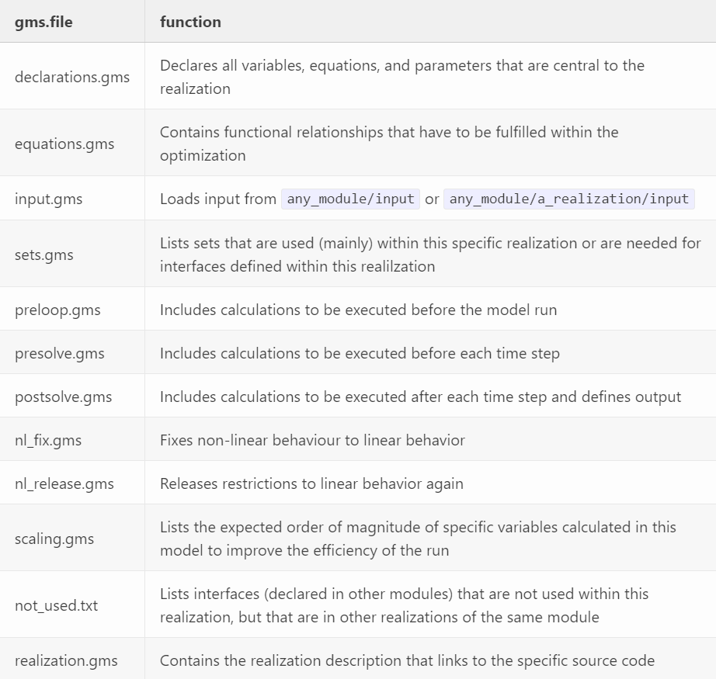
Structure of realizations
As with the modules folders, the realizations files (.gms) and folders are similarly build. The source code is distributed over several gms-files to ensure the correct order of calculations during the optimization:
Note that not every gms-file is needed in every realization.

Slide 8
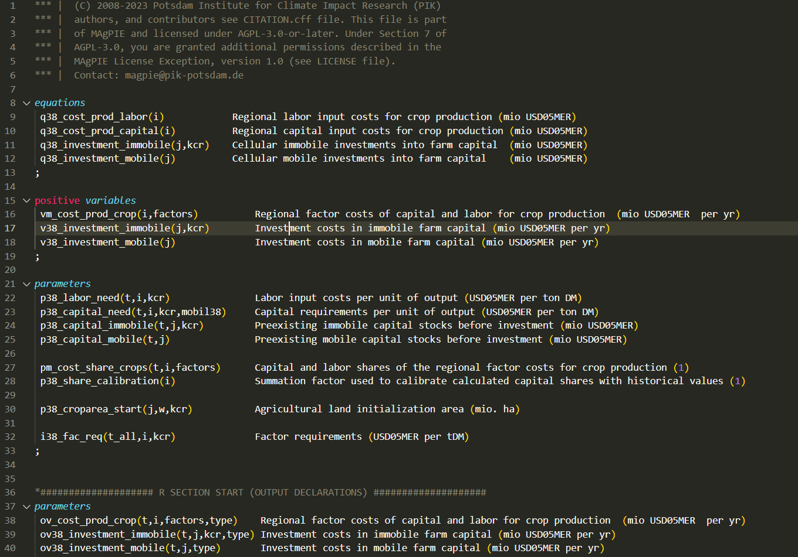
Coding etiquette: Variable and parameter naming
Prefixes are extended using either m (used in multiple modules/core code) or a two digit number (only used in the current module).
}
q_ Equations
}
v_ Variables
}
p_ processing parameters
… In other files you will also find:
c_ Switch
s_ Scalars
f_ File parameter
m_ macros
}
i_ input parameters
}
o_ output parameters

Slide 9
Coding etiquette: Variable and parameter naming
In other cases, the prefixes are extended with a second letter to indicate details such as:
?c_ current time step
?q_ parameter containing the value of an equation
?v_ parameter containing the values of a variable
Suffixes indicate the level of aggregation of an object
(no suffix) Highest disaggregation available
_setname aggregation over set
_reg regional aggregation
_glo global aggregation

Slide 10
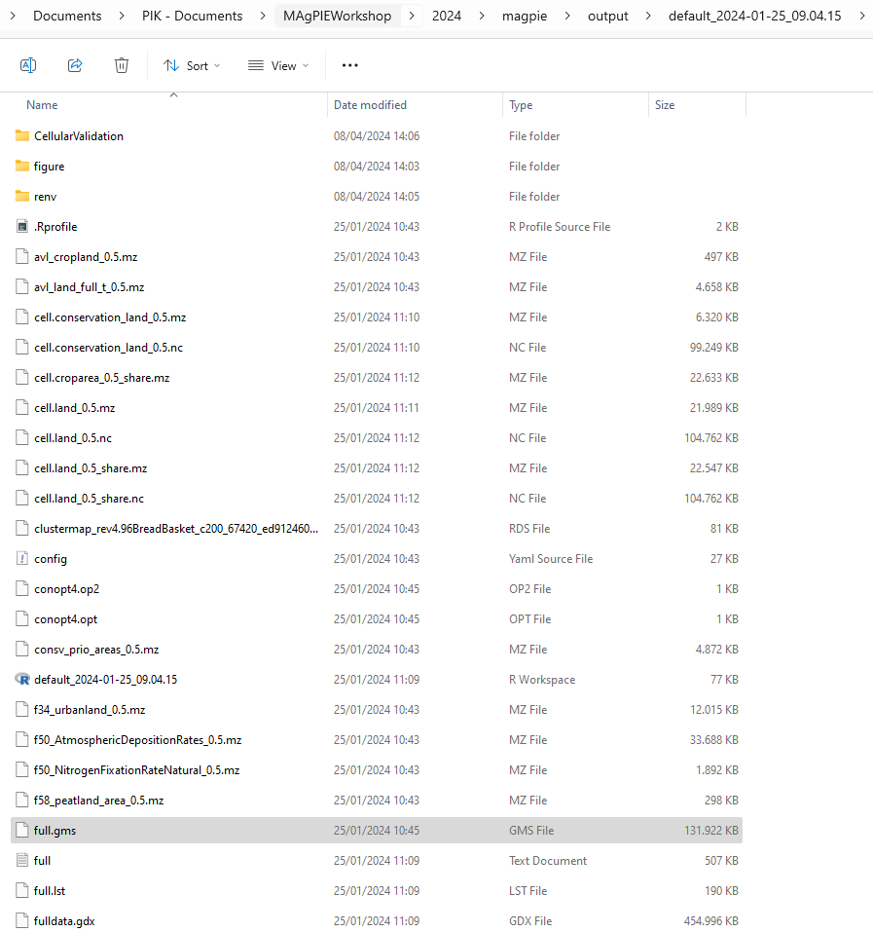
The full.gms file
Once you have started a magpie run, in the ouput folder, you’ll find the full.gms file.
Contains the final code used in the current MAgPIE run, based on the selected settings and on one realization per module (done automatically)

Slide 11

Brief exercise
(For online participants: Green tick when you are ready )
Within the magpie folder, find the 14_yield module.
Open the declaration.gms file of the managementcalib_aug19 realization
One example of:
Parameter used only within the current module
An equation
A processing parameter used in this module and the core code.
An output parameter

Slide 12
Thank you
mbacca@pik-potsdam.de

